Slide 1

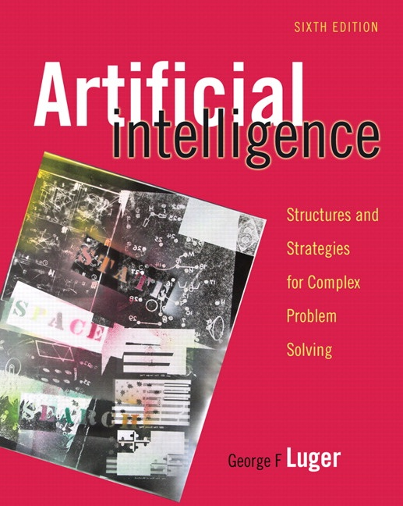
The Predicate Calculus
2.0 Introduction
2.1 The Propositional Calculus
2.2 The Predicate Calculus
2.3 Using Inference Rules to Produce Predicate Calculus Expressions
2.4 Application: A Logic-Based Financial Advisor
2.5 Epilogue and References
2.6 Exercises
George F Luger
ARTIFICIAL INTELLIGENCE 6th edition
Structures and Strategies for Complex Problem Solving
Luger: Artificial Intelligence, 6th edition. © Pearson Education Limited, 2009
Notes:
OWEN: Insert chapter number

Slide 2
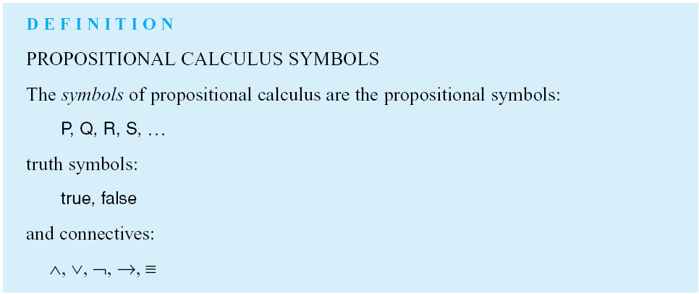
Luger: Artificial Intelligence, 6th edition. © Pearson Education Limited, 2009

Slide 3
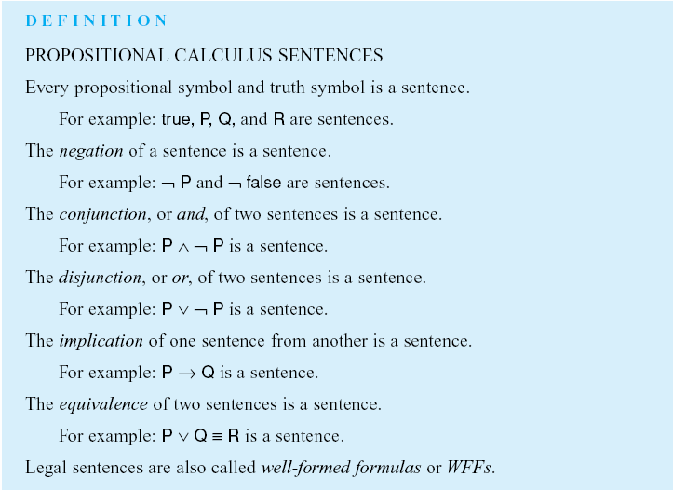
Luger: Artificial Intelligence, 6th edition. © Pearson Education Limited, 2009

Slide 4
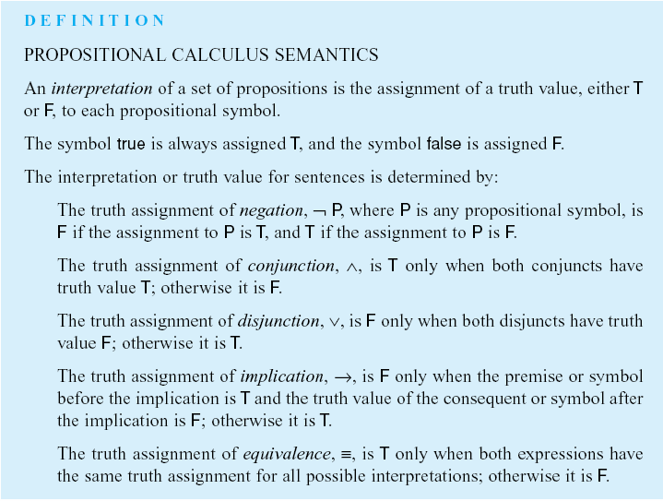
Luger: Artificial Intelligence, 6th edition. © Pearson Education Limited, 2009

Slide 5
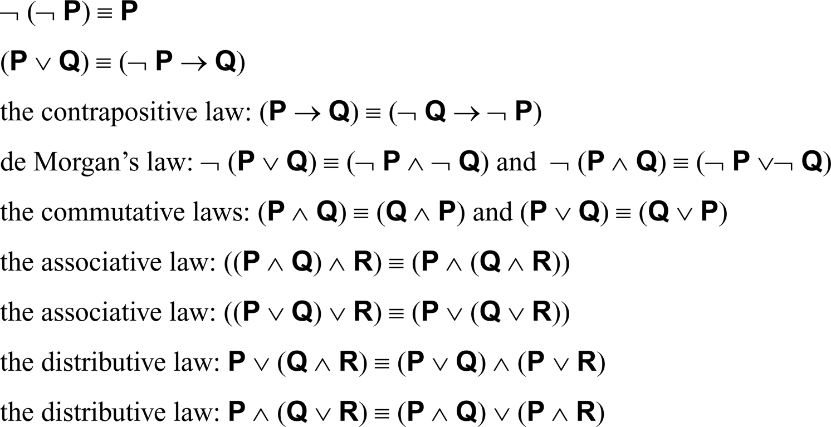
For propositional expressions P, Q and R:
Luger: Artificial Intelligence, 6th edition. © Pearson Education Limited, 2009

Slide 6
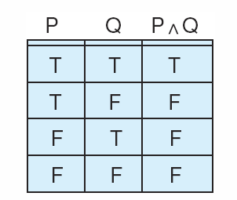
Figure 2.1: Truth table for the operator ∧.
Luger: Artificial Intelligence, 6th edition. © Pearson Education Limited, 2009

Slide 7
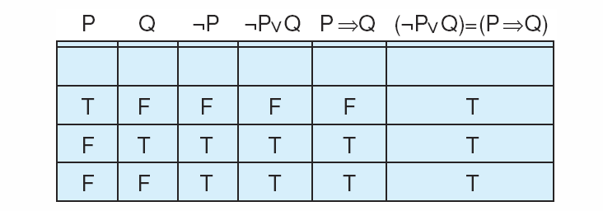
Figure 2.2: Truth table demonstrating the equivalence of P Æ Q and ÿ P ⁄ Q.
Luger: Artificial Intelligence, 6th edition. © Pearson Education Limited, 2009

Slide 8
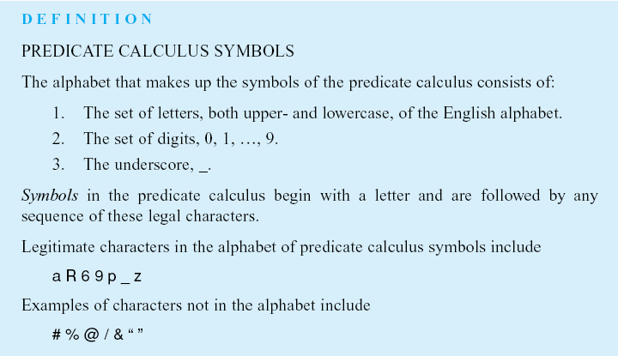
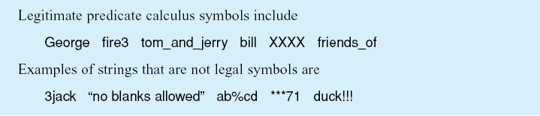
Luger: Artificial Intelligence, 6th edition. © Pearson Education Limited, 2009

Slide 9
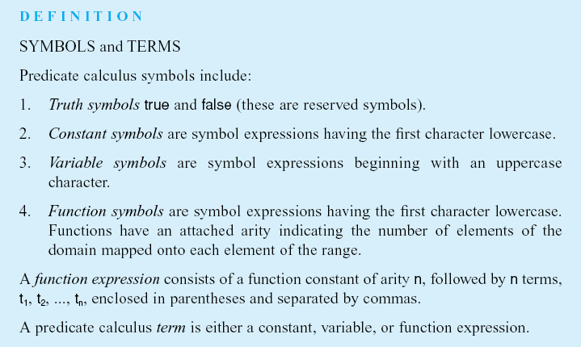
Luger: Artificial Intelligence, 6th edition. © Pearson Education Limited, 2009

Slide 10
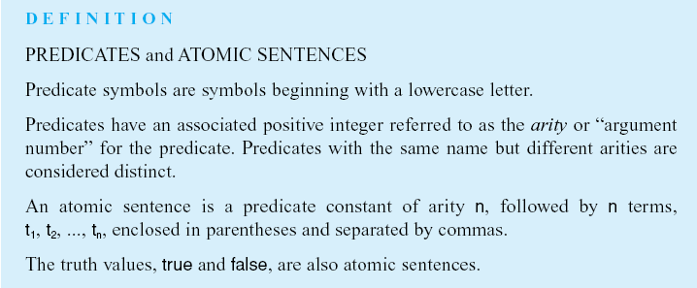
Luger: Artificial Intelligence, 6th edition. © Pearson Education Limited, 2009

Slide 11
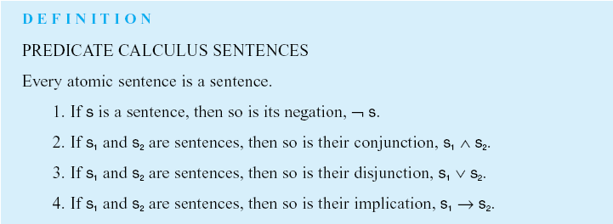
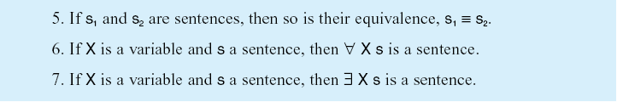
Luger: Artificial Intelligence, 6th edition. © Pearson Education Limited, 2009

Slide 12
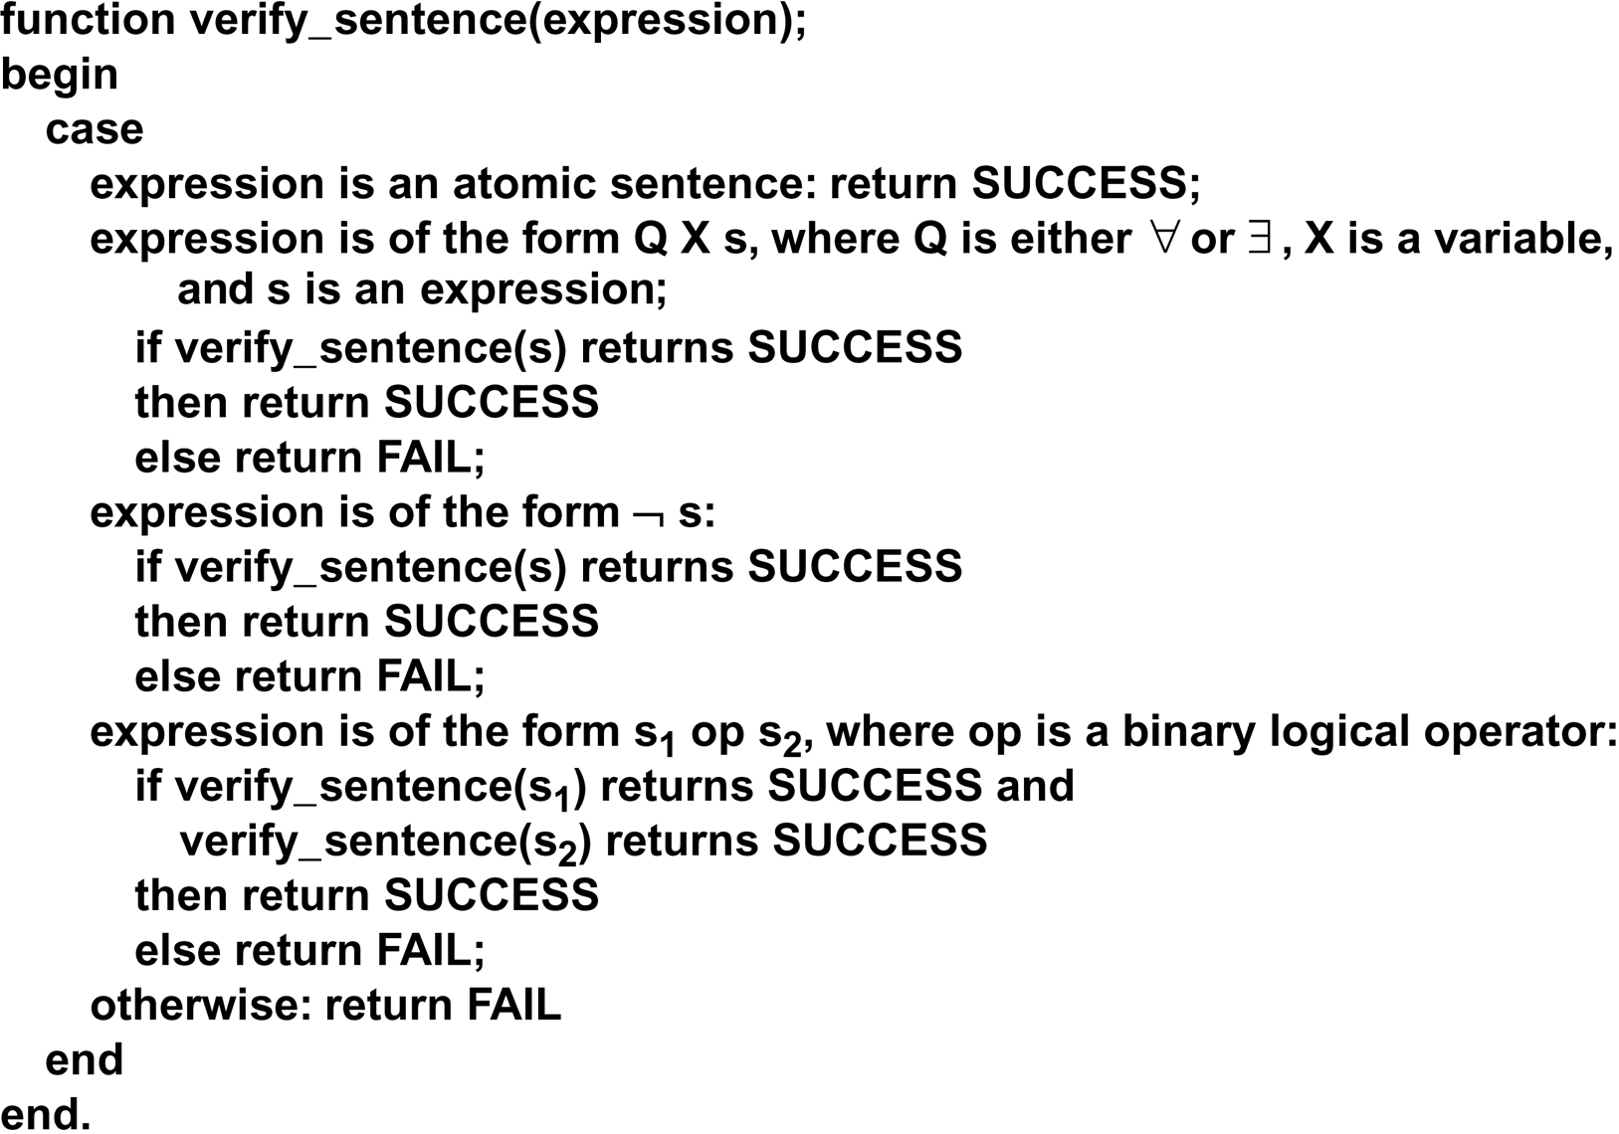
verify_sentence algorithm
Luger: Artificial Intelligence, 6th edition. © Pearson Education Limited, 2009

Slide 13
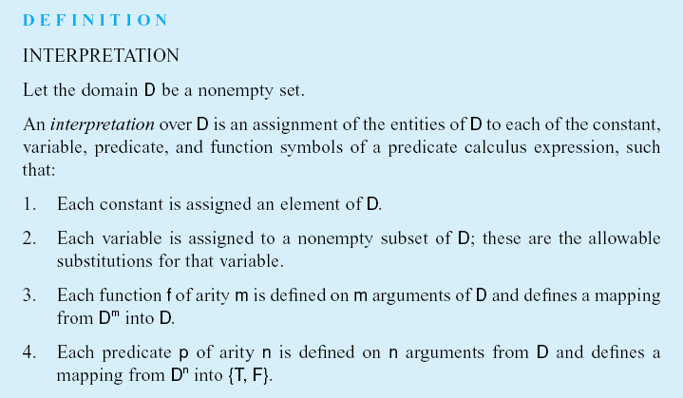
Luger: Artificial Intelligence, 6th edition. © Pearson Education Limited, 2009

Slide 14
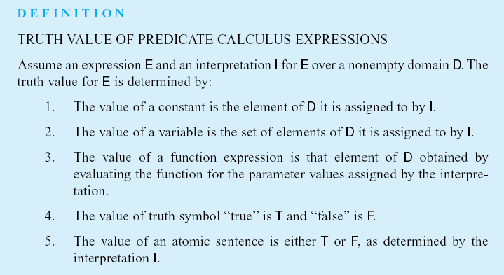
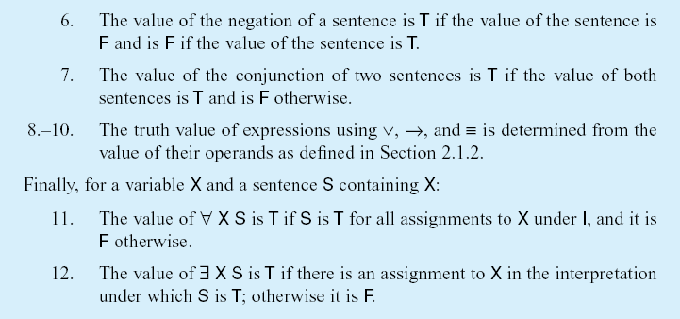
Luger: Artificial Intelligence, 6th edition. © Pearson Education Limited, 2009

Slide 15
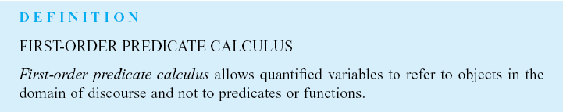
Luger: Artificial Intelligence, 6th edition. © Pearson Education Limited, 2009

Slide 16
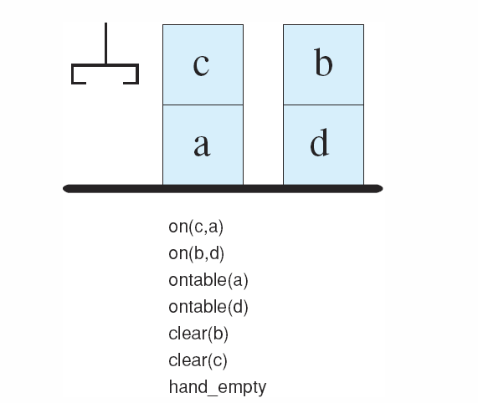
Figure 2.3: A blocks world with its predicate calculate description.
Luger: Artificial Intelligence, 6th edition. © Pearson Education Limited, 2009

Slide 17
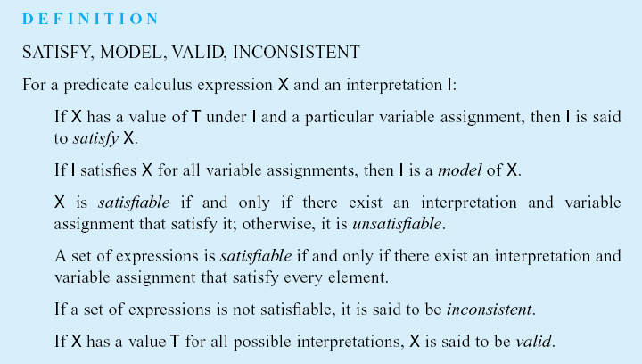
Luger: Artificial Intelligence, 6th edition. © Pearson Education Limited, 2009

Slide 18
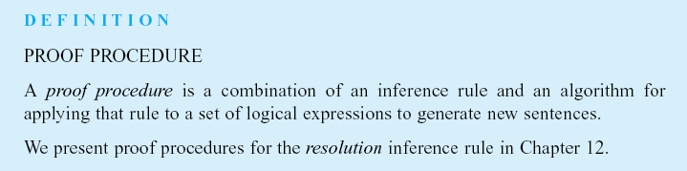
Luger: Artificial Intelligence, 6th edition. © Pearson Education Limited, 2009

Slide 19
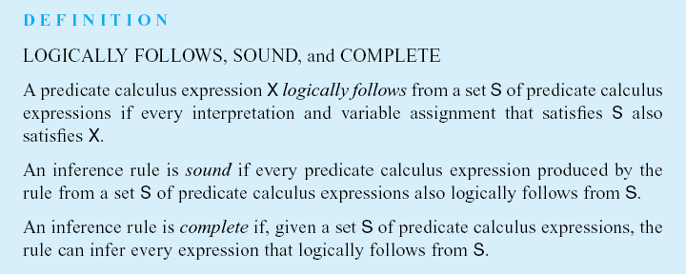
Luger: Artificial Intelligence, 6th edition. © Pearson Education Limited, 2009

Slide 20
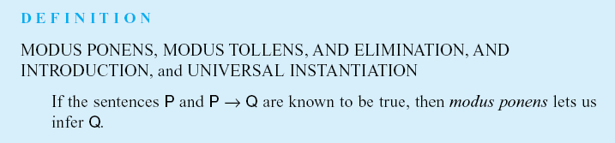
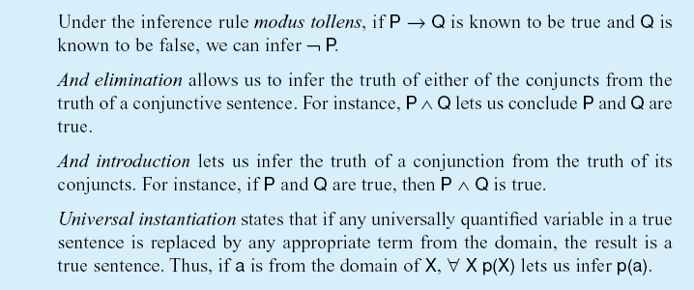
Luger: Artificial Intelligence, 6th edition. © Pearson Education Limited, 2009

Slide 21
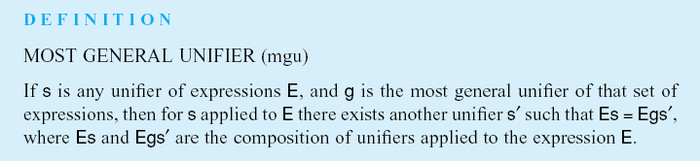
Luger: Artificial Intelligence, 6th edition. © Pearson Education Limited, 2009

Slide 22
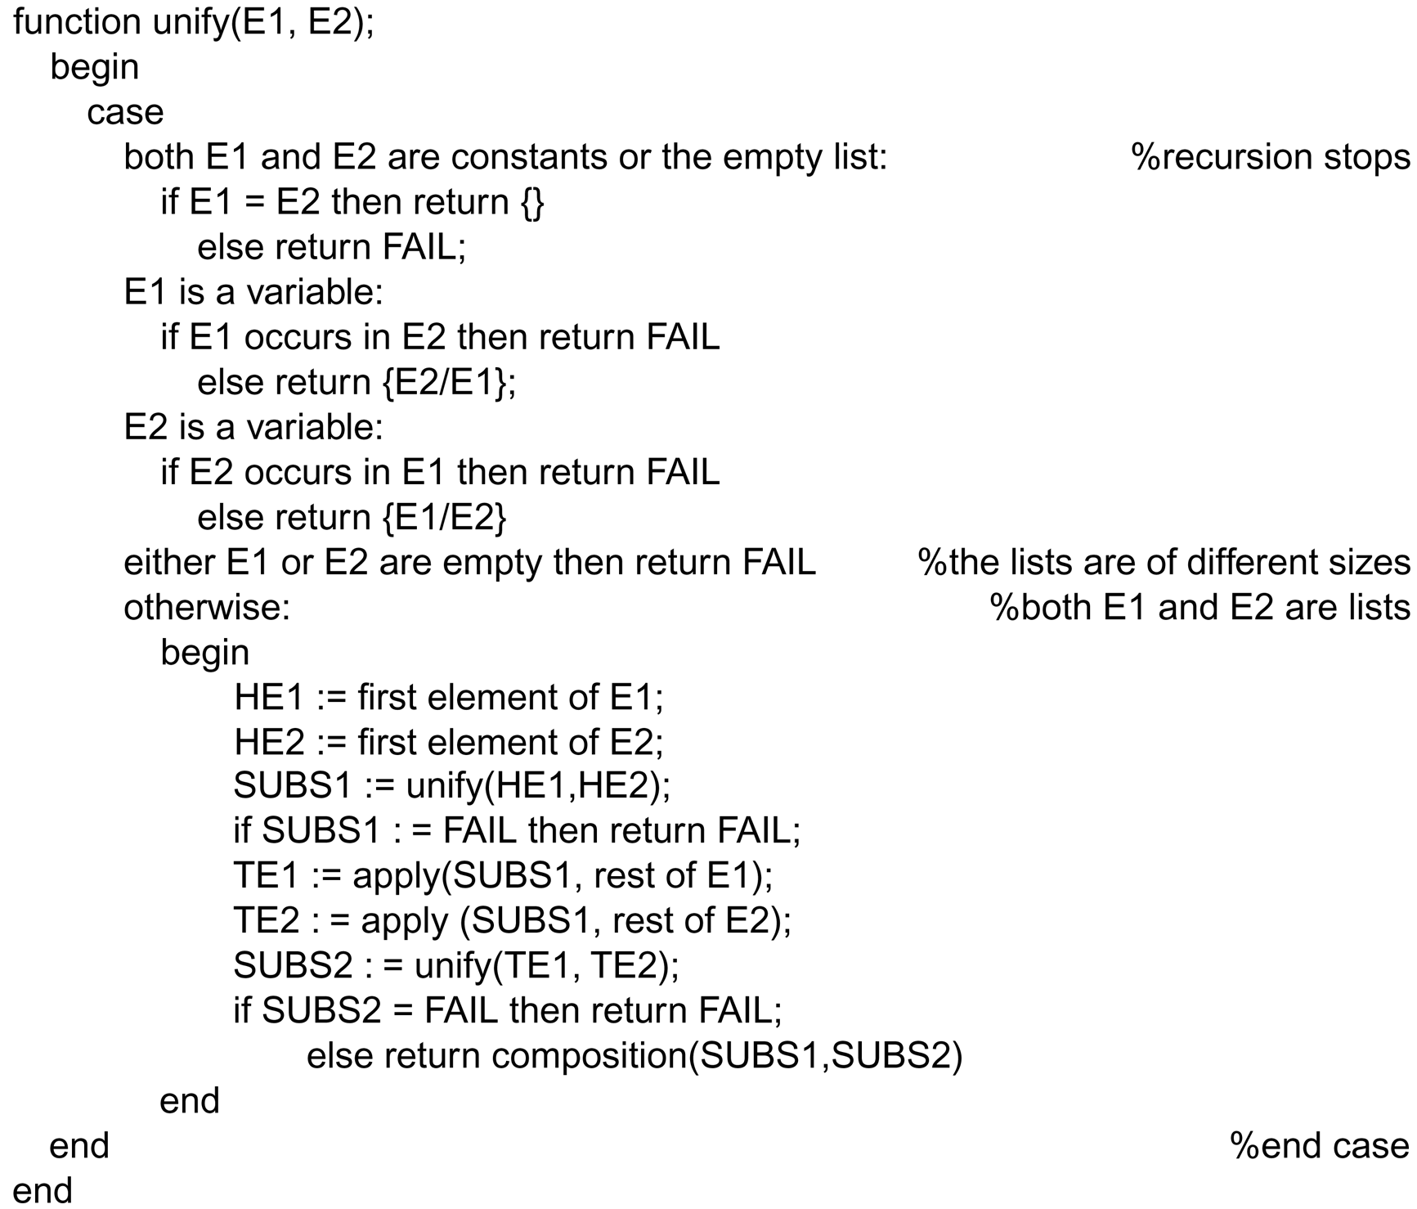
Luger: Artificial Intelligence, 6th edition. © Pearson Education Limited, 2009

Slide 23
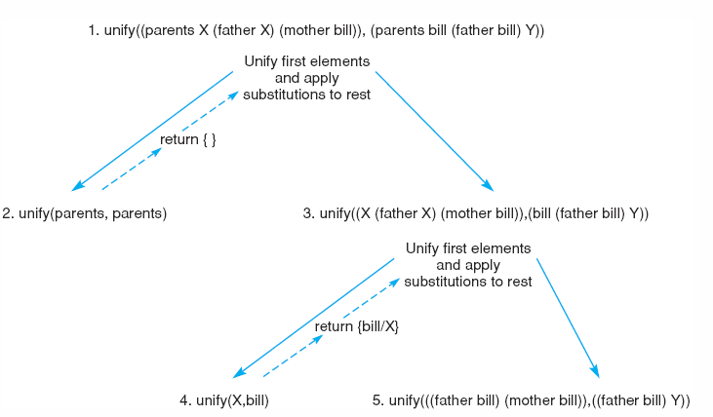
Figure 2.5: Further steps in the unification of (parents X (father X) (mother bill)) and (parents bill (father bill) Y).
Luger: Artificial Intelligence, 6th edition. © Pearson Education Limited, 2009

Slide 24
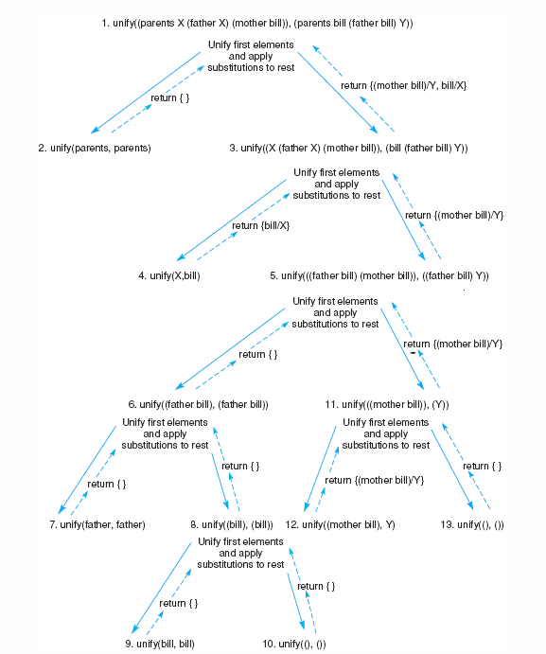
Figure 2.6: Final trace of the unification of (parents X (father X) (mother bill)) and (parents bill (father bill) Y).
Luger: Artificial Intelligence, 6th edition. © Pearson Education Limited, 2009
Notes:
OWEN: Insert fig 2.6

Slide 25
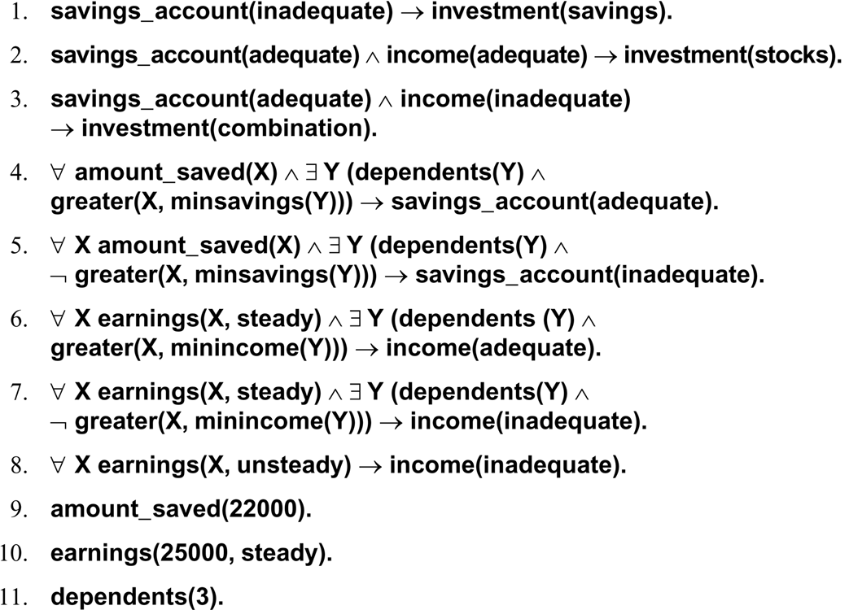
Luger: Artificial Intelligence, 6th edition. © Pearson Education Limited, 2009

